Slide 1
S-GEMS Modeling response uncertainty
Modeling Uncertainty in the Earth Sciences

Slide 2
Download from coursework
Matlab.zip (under “code” folder)

Slide 3
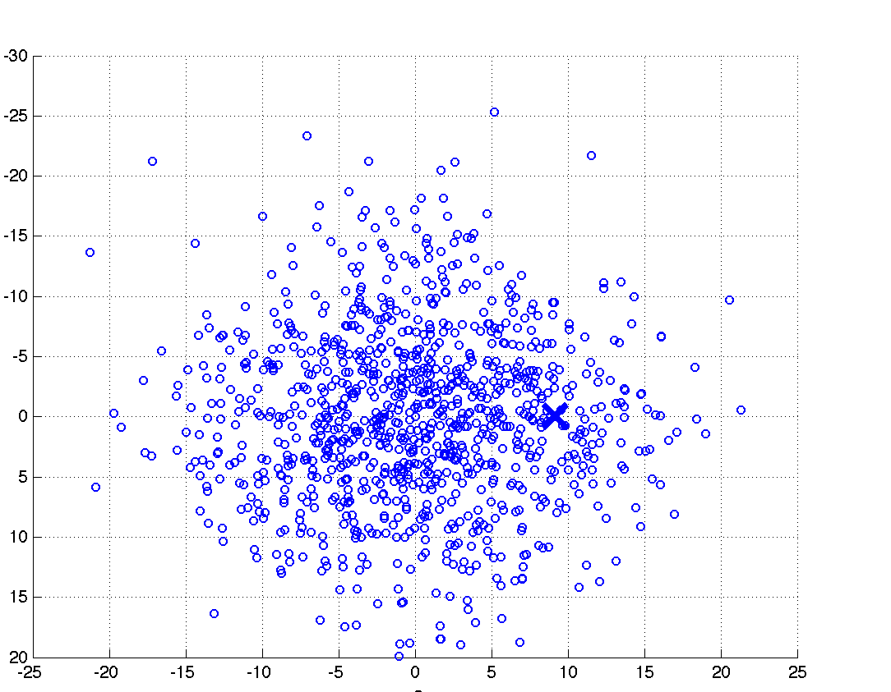
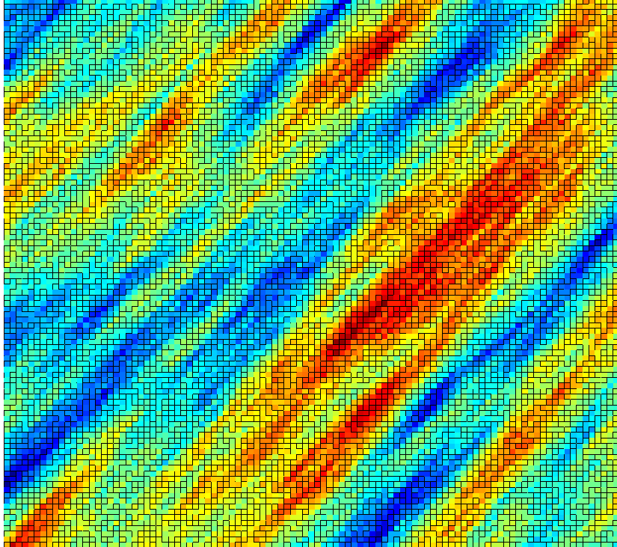
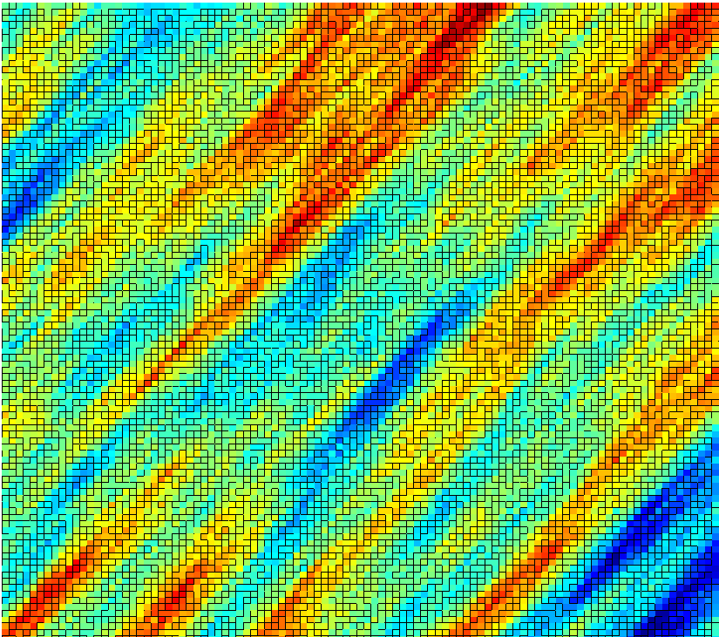
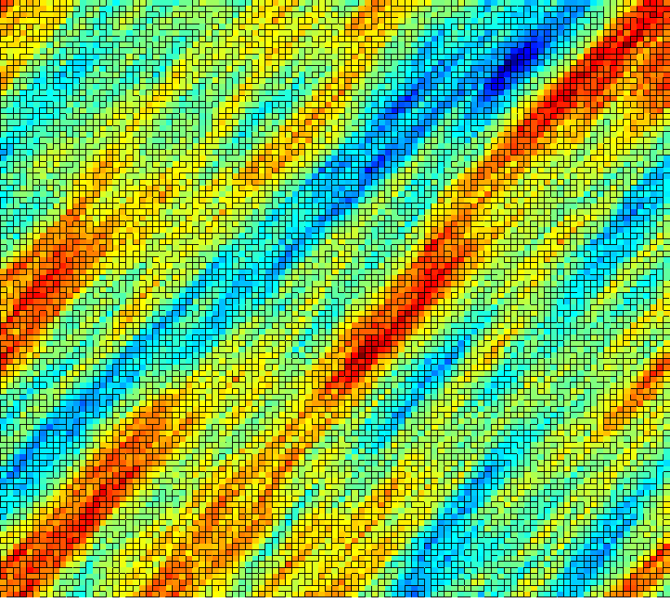
Distances: multi-dimensional scaling
1000 SGSIM model
2D map of Earth models:
explicit visualization of uncertainty
Calculate Euclidean distance

Slide 4
MDS summary

Slide 5
Example: Earth models
Created 405 2D channel Earth models
with different proportion, direction, width

Slide 6
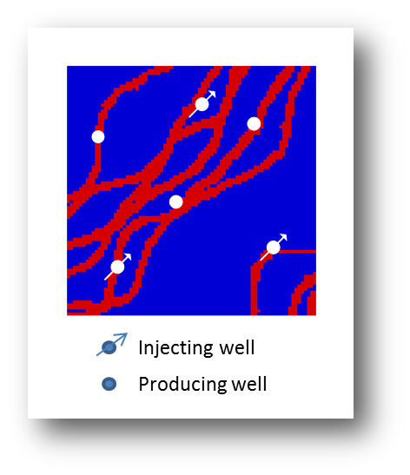
Example: response
Basic questions
What is the uncertainty in Oil production over time in terms of [P10, P90]?
What are the most influencing factors ?
True response takes too long to evaluate on 405 models.
We have a proxy response

Slide 7
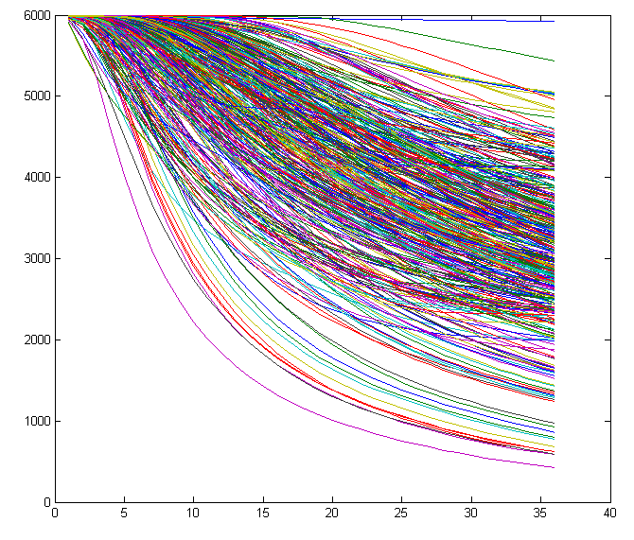
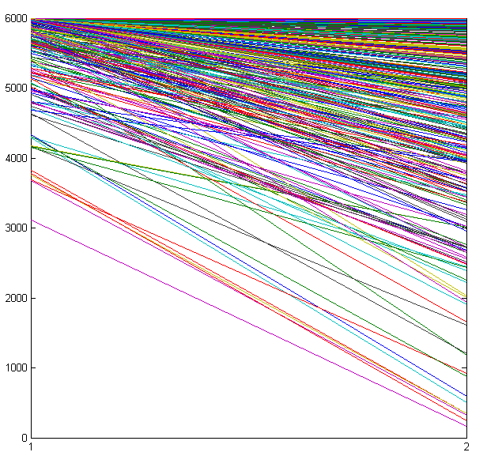
Responses
True Response
Proxy Response
Oil production
Oil production
time
another time

Slide 8
Multi-dimensional scaling in MATLAB
Calculating distances
dvector = pdist(response)
d = squareform(dvector)
Basic command for MDS
[Y e] = cmdscale(d)
Plotting
scatter for 2D plots
scatter3 for 3D plots
plot_MDS_response_value for adding a color that corresponds to some (single) response value

Slide 9
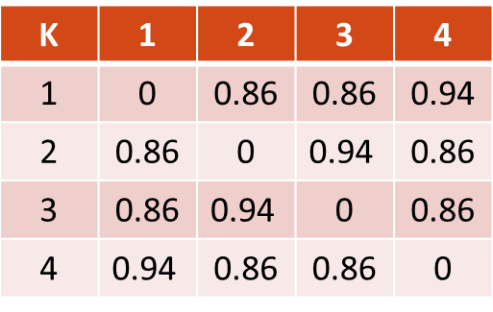
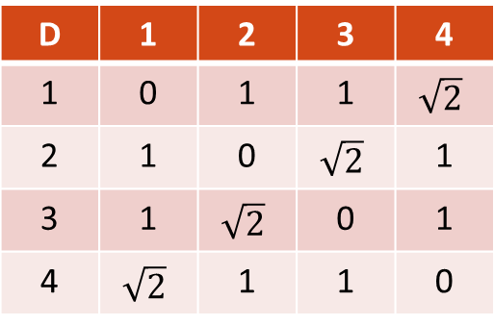
Kernel transformation
distance
new distance
D | 1 | 2 | 3 | 4
1 | 0 | 1 | 1 | $$\sqrt{2}$$
2 | 1 | 0 | $$\sqrt{2}$$ | 1
3 | 1 | $$\sqrt{2}$$ | 0 | 1
4 | $$\sqrt{2}$$ | 1 | 1 | 0
K | 1 | 2 | 3 | 4
1 | 0 | 0.86 | 0.86 | 0.94
2 | 0.86 | 0 | $$\text{0.94}$$ | 0.86
3 | 0.86 | $$\text{0.94}$$ | 0 | 0.86
4 | $$\text{0.94}$$ | 0.86 | 0.86 | 0
k= 1-exp(-d)
λ₁ = λ₂ = 1
λ₃ = λ₄ = 0
λ₁ = λ₂ = 0.44
λ₃ = 0.31
λ₄ = 0

Slide 10
Kernel transformation
Transformation from one metric space to another does not
require knowledge of ϕ, only knowledge of the dot-product ϕ^{T} ϕ
Euclidean distance
obtained with MDS
Role of the Kernel
Increase dimension, seperability and linearity

Slide 11
Command
Radial basis kernel
Input = coordinates after projection with MDS
Output = Kernel matrix K
K=rbf_kernel(coord)

Slide 12
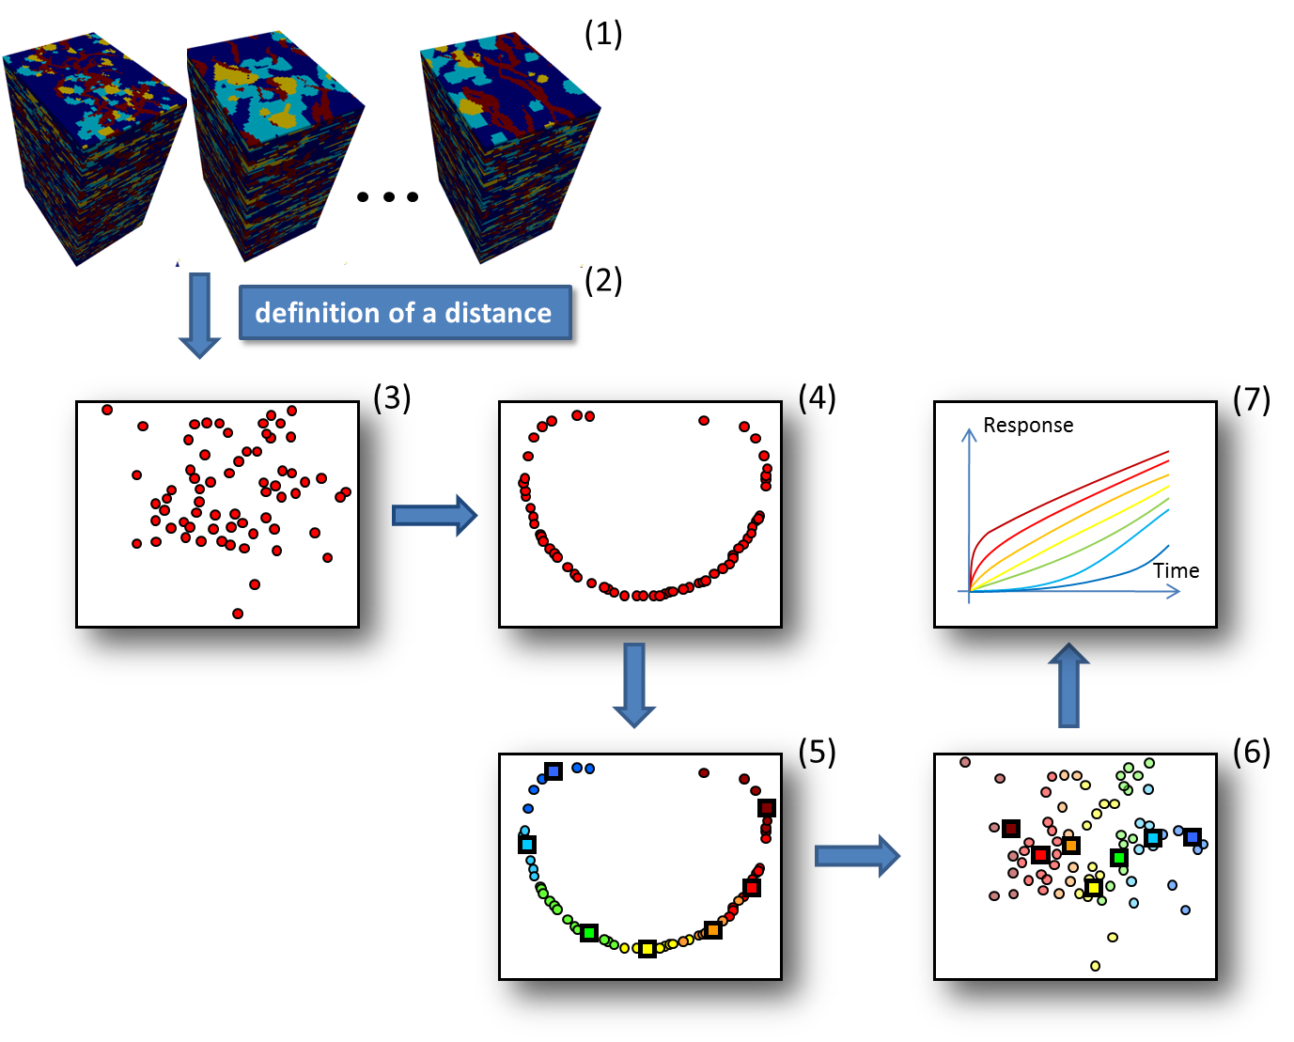
Clustering Earth models

Slide 13
Script
kmedoids.m
Input (in script)
Number of clusters
Number of iterations

Slide 14
Response calculation
Response of 7 selected Earth models
Calculated P10, P50 and P90

Slide 15
Command
Quantiles_Calculation
Input
Responses
Vector containing percentages corresponding to the quantiles you want to calculate, e.g. [0.10 0.50 0.90]
Output: quantiles of the responses

Slide 16
Sensitivity analysis
MDS
Clustering
Samsung
Made in USA
Samsung
Made in Patagonia
Motorola
Made in Patagonia
Samsung
Made in USA
Samsung
Made in Patagonia
Motorola
Made in USA

Slide 17
Command
Sensitivity_Analysis_Classical
Input
Parameter values (experimental design indicators)
Responses belong to those parameter values
Parameter names
Flag variable to indicate whether you want to study interaction
Output
Effect estimates for all parameters

